Slide 1

Satish Sarfare
Head, Department of Zoology
SIES College
© satish sarfare

Slide 2
Interdisciplinary Approach
Biology
Physics
Chemistry
© satish sarfare

Slide 3
Teaching - Learning Strategy
Learn
Relearn
Unlearn
© satish sarfare

Slide 4
F.Y.B.Sc – Zoology – Semester I – Course 2
Unit 3 – Instrumentation
Objectives
Increase awareness about instruments and hazardous chemicals
Training for handling, use, care and maintenance of instruments
Desired Outcome
Learn and improve skills in selection and use of instruments
Learn good laboratory and safety practices
© satish sarfare

Slide 5
Topics to be learnt under – Instrumentation
Structure, principle and applications of compound microscope and dissecting
microscope
Principle and applications of scanning electron microscope, transmission electron microscope, phase contrast microscope and fluorescence microscope
Colorimetry – principle and applications
pH – Sorenson's pH scale, pH meter – principle and applications
Centrifuge – principle, types (clinical, ultracentrifuges) and applications
Chromatography – principle, types (paper, thin layer, column) and applications
Electrophoresis – principle, types (Agarose Gel Electrophoresis and
PolyAcrylamide Gel Electrophoresis) and applications
© satish sarfare

Slide 6
Introduction to the Microscope
History
Types
Parts & functions
Focusing
Care
© satish sarfare

Slide 7
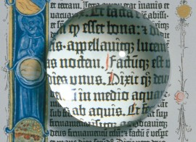
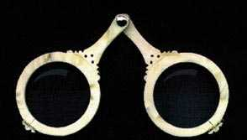
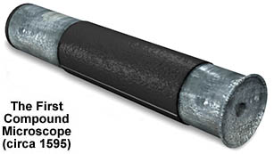
Microscope History
Circa 1000AD – The first vision aid was invented (inventor unknown) called a reading stone. It was a glass sphere that magnified when laid on top of reading materials.
Circa 1284 – Italian, Salvino D'Armate is credited with inventing the first wearable eye glasses.
1590 – Two Dutch eye glass makers, Zaccharias Janssen and son Hans Janssen experimented with multiple lenses placed in a tube. The Janssens observed that viewed objects in front of the tube appeared greatly enlarged, creating both the forerunner of the compound microscope and the telescope.
© satish sarfare

Slide 8
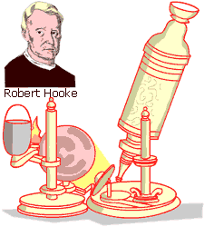
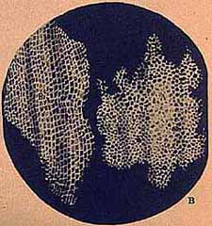
Microscope History
1665 – English physicist, Robert Hooke looked at a sliver of cork through a microscope lens and noticed some "pores" or "cells" in it.
1674 – Antony van Leeuwenhoek built a simple microscope with only one lens to examine blood, yeast, insects and many other tiny objects. Leeuwenhoek was the first person to describe bacteria, and he invented new methods for grinding and polishing microscope lenses that allowed for curvatures providing higher magnifications, the best available lenses at that time.
© satish sarfare

Slide 9
Microscope History
18th century – Technical innovations improved microscopes, leading to microscopy becoming popular among scientists. Lenses combining two types of glass reduced the "chromatic effect" the disturbing halos resulting from differences in refraction of light.
1830 – Joseph Jackson Lister reduces spherical aberration or the "chromatic effect" by showing that several weak lenses used together at certain distances gave good magnification without blurring the image. This was the prototype for the compound microscope.
1872 – Ernst Abbe, then research director of the Zeiss Optical Works, wrote a mathematical formula called the "Abbe Sine Condition". His formula provided calculations that allowed for the maximum resolution in microscopes possible.
© satish sarfare

Slide 10
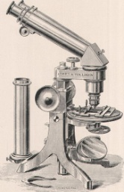
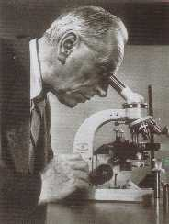
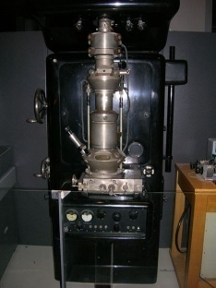
Microscope History
1903 – Richard Zsigmondy developed the ultra microscope that could study objects below the wavelength of light. He won the Nobel Prize in Chemistry in 1925.
1932 – Frits Zernike invented the phase-contrast microscope that allowed for the study of colorless and transparent biological materials for which he won the Nobel Prize in Physics in 1953.
1931 – Ernst Ruska co-invented the electron microscope for which he won the Nobel Prize in Physics in 1986. It is possible to view objects as small as the diameter of an atom.
© satish sarfare

Slide 11
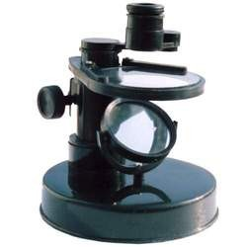
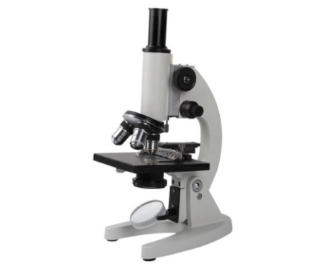
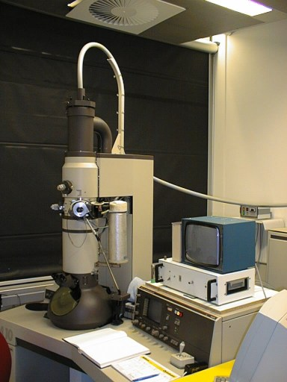
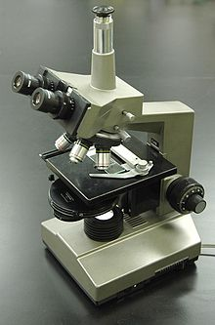
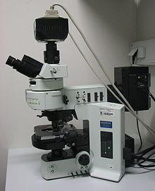
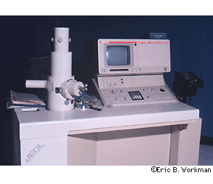
Types of Microscopes
Simple / Dissecting Microscope
Compound Microscope
Transmission Electron Microscope (TEM)
Phase contrast Microscope
Fluorescence Microscope
Scanning Electron Microscope
(SEM)
© satish sarfare

Slide 12
Microscope Vocabulary
Magnification: increase of an object’s apparent size
Resolution: power to show details clearly
Both are needed to see a clear image
© satish sarfare

Slide 13
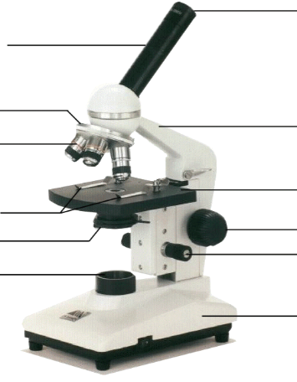
Microscope Parts
Eyepiece (Ocular Lens)
Body Tube
Revolving Nosepiece
Arm
Objective Lens
Stage
Stage Clips
Coarse Focus
Condenser Lens with Diaphragm
Fine Focus
Light
Base
© satish sarfare
Notes:
This is the exact version of the microscope used in class. Students will be identifying the parts on the microscopes at their desks as we go along and what their functions are.

Slide 14
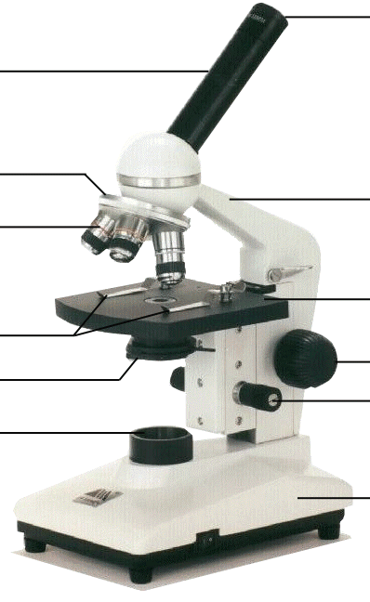
Light
Source of illumination
Makes the specimen easier to see
light
© satish sarfare

Slide 15
Condenser lens with Diaphragm
Controls the amount of light going through the specimen
Many microscopes have a rotating disk under the stage. This
diaphragm has different sized holes and is used to vary the intensity
and size of the cone of light that is projected upward into the slide.
There is no set rule regarding which setting to use for a particular
power. Rather, the setting is a function of the transparency of the
specimen, the degree of contrast you desire and the particular
objective lens in use.
Condenser lens with diaphragm
© satish sarfare

Slide 16
Objective lenses
Adds to the magnification
Usually you will find 3 or 4 objective lenses on a microscope
They almost always consist of 4X, 10X, 40X and 100X powers
When coupled with a 10X (most common)
objective lens
© satish sarfare

Slide 17
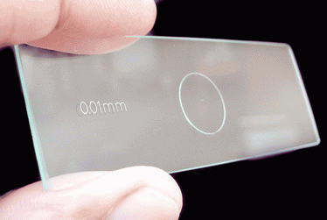
Objective lenses
The shortest lens is the lowest power
The longest one is the lens with the greatest power
The lenses are color coded
When objective lens is coupled with eyepiece lens, we get
total magnifications of 40X (4X times 10X), 100X , 400X
and 1000X
objective lens
Objective micrometer
© satish sarfare

Slide 18
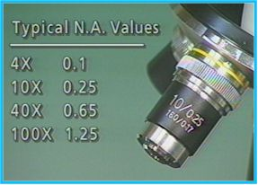
Objective lenses
The high power objective lenses are retractable
(i.e. 40XR). This means that if they hit a slide, the end
of the lens will push in (spring loaded) thereby
protecting the lens and the slide.
objective lens
The yellow band tells us that it is a 10X objective lens. Red is 4X, Blue is 40X and White is 100X. The first number "10" is the power (10X). The 0.25 is the Numerical Aperture. The 160 is a standard DIN (Deutsches Institut für Normung) (DIN; in English, the German Institute for Standardization) measurement in millimeters of the tube length of the microscope required for this lens to work properly. Finally, the 0.17 is the thickness in mm of the cover slip that you should use. 0.17mm cover slips correspond to a number 1 cover slip.
© satish sarfare

Slide 19
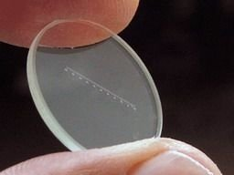
Ocular lens
Eyepiece / Ocular lens
Magnifies; where you look through to see the
image of your specimen
They are usually 10X or 15X power
Our microscopes have an ocular lens power of 10X
Ocular micrometer
© satish sarfare

Slide 20
Coarse adjustment knob
Moves stage (or body tube) up and down
coarse adjustment knob
© satish sarfare

Slide 21
Fine adjustment knob
Small, round knob on the side of the microscope
used to fine-tune the focus of your specimen
Should be used after using the coarse adjustment
knob
fine adjustment knob
© satish sarfare

Slide 22
Body tube
body tube
Connects the eyepiece to the objective lenses
© satish sarfare

Slide 23
Revolving nosepiece
revolving nosepiece
The part that holds two or more objective lenses
Can be rotated to easily change power
© satish sarfare

Slide 24
stage
stage
The flat platform where you place your slide
© satish sarfare

Slide 25
Stage clips
Stage clips hold the slides in place
If your microscope has a mechanical stage, you will be able to
move the slide around by turning two knobs
One moves it left and right, the other moves it up and down
stage clips
© satish sarfare

Slide 26
arm
arm
Supports the tube and connects it to the base
© satish sarfare

Slide 27
Base
The bottom of the microscope, used for support
base
© satish sarfare

Slide 28
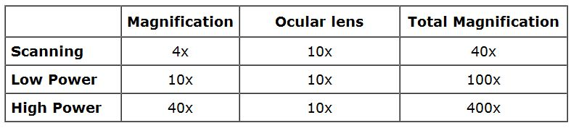
Your microscope has 3 magnifications: Scanning, Low and High
Each objective will have written the magnification.
In addition to this, the ocular lens (eyepiece) has a magnification.
The total magnification is the ocular x objective
Magnification
© satish sarfare

Slide 29
Using the Microscope
Focusing specimens
Always start with the scanning objective
Odds are, you will be able to see something on this setting
Use the Coarse Knob to focus, image may be small at this
magnification, but you won't be able to find it on the higher powers
without this first step
Do not use stage clips, try moving the slide around until you find
something
© satish sarfare
Notes:
Give students a slide from the “common things” set, each student will practice focusing and changing objectives.

Slide 30
Using the Microscope
Once you've focused on Scanning, switch to Low Power.
Use the Coarse Knob to refocus.
Again, if you haven't focused on this level, you will not be able to move to the next level.
Now switch to High Power. (If you have a thick slide, or a slide without a cover, do NOT use the high power objective).
At this point, ONLY use the Fine Adjustment Knob to focus specimens.
Recap
1. Scanning --> use coarse knob
2. Low power --> use coarse knob
3. High power --> use fine knob
DO NOT SKIP STEPS!!!!
© satish sarfare

Slide 31
Using the Microscope
Your slide MUST be focused on low power before attempting this step
Click the nosepiece to the longest objective
Do NOT use the Coarse Focusing Knob, this could crack the slide or the lens
Use the Fine Focus Knob to bring the slide
© satish sarfare
Notes:
Have students exchange slides so they can look at different things, walk them through using the high power objective to focus slides. Emphasize not using the coarse objective during this process, as it will crack the slides.

Slide 32
Using the Microscope
The proper way to focus a microscope is to start with the lowest power objective lens first and while looking from the side, crank the lens down as close to the specimen as possible without touching it. Now, look through the eyepiece lens and focus upward only until the image is sharp. If you can't get it in focus, repeat the process again.
Once the image is sharp with the low power lens, you should be able to simply click in the next power lens and do minor adjustments with the focus knob. If your microscope has a fine focus adjustment, turning it a bit should be all that's necessary. Continue with subsequent objective lenses and fine focus each time.
© satish sarfare

Slide 33
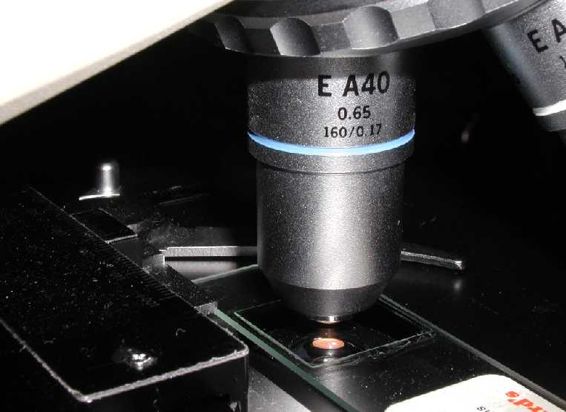
Using High Power
Rotate to 40X objective.
Locate desired portion of specimen in the center of the field.
Refocus very carefully so that the specimen is focused as sharply as possible.
(Do not alter focus for the Following steps )
© satish sarfare

Slide 34
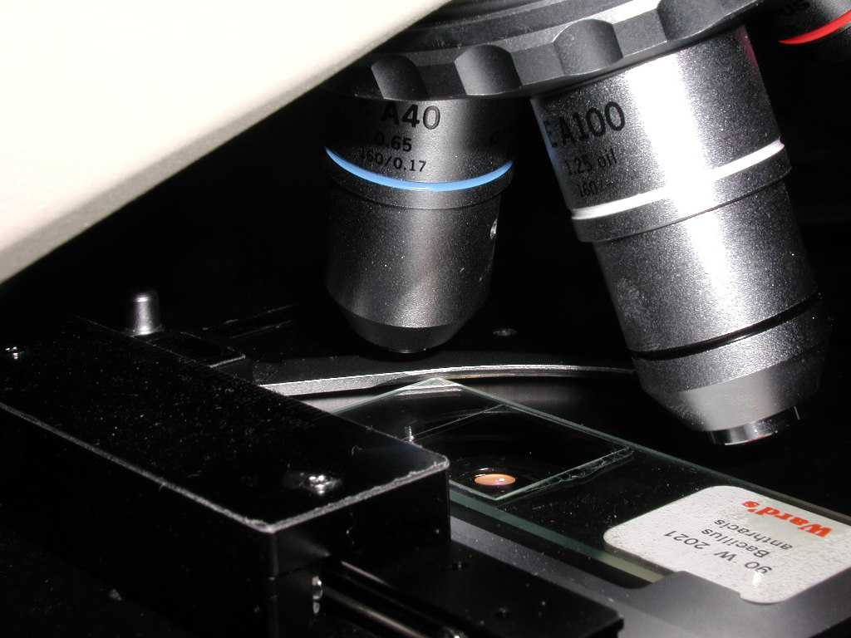
Using High Power
Partially rotate so that 40X and 100X objectives straddle the specimen.
© satish sarfare

Slide 35
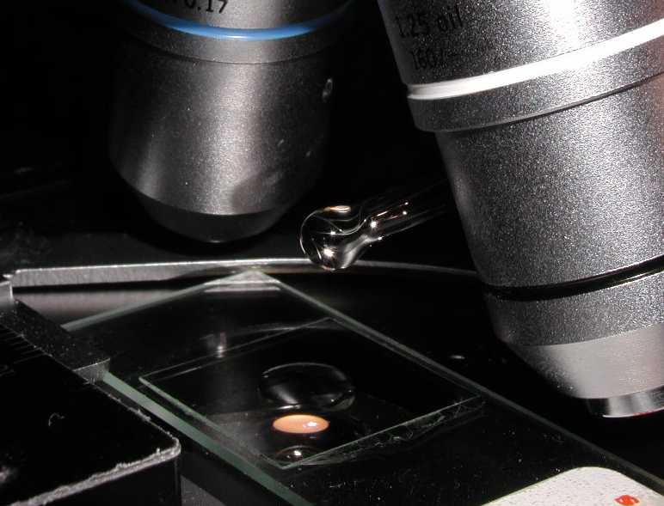
Using High Power
Place a small drop of oil on the slide in the center of the lighted area.
(Take care not to dribble on the stage)
Put the small drop of oil directly over the area of the specimen to be Examined.
© satish sarfare

Slide 36
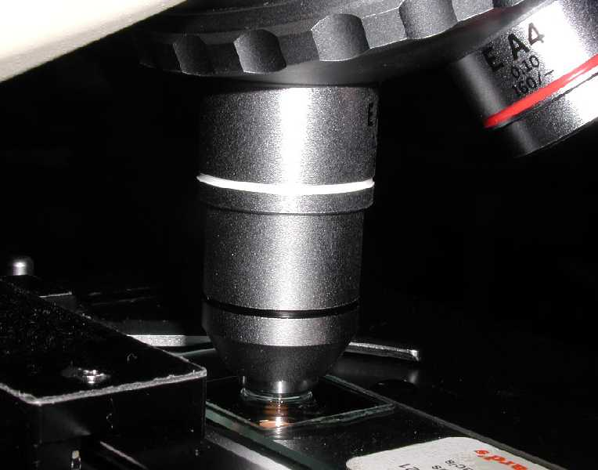
Using High Power
Rotate so that the 100X oil immersion objective touches the oil and clicks into place.
© satish sarfare

Slide 37
Using High Power
Focus only with fine focus.
Hopefully, the specimen will come into focus easily.
Do not change focus dramatically.
© satish sarfare

Slide 38
Using High Power
Clean up!: When you have finished for the day.
Wipe the 100x oil immersion objective carefully with lens paper to remove all oil.
Wipe oil from the slide thoroughly with a Kim wipe.
Cleanse stage should any oil have spilled on it.
Recap the immersion oil container securely, replace in drawer.
© satish sarfare

Slide 39
Microscope Care
Always carry with 2 hands
Never touch the lenses with your fingers
Only use lens paper for cleaning
Do not force knobs
Keep objects clear of desk and cords
When you are finished with your "scope", rotate the nosepiece so that it's on the low power objective
Roll the stage down to lowest level and then replace the dust cover
© satish sarfare

Slide 40
Troubleshooting
Occasionally you may have trouble with working your microscope. Here are some common problems and solutions.
1. Image is too dark!
Adjust the diaphragm, make sure your light is on.
2. There's a spot in my viewing field, even when I move the slide the spot stays in the same place!
Your lens is dirty. Use lens paper, and only lens paper to carefully clean the objective and ocular lens. The ocular lens can be removed to clean the inside. The spot is probably a spec of dust.
3. I can't see anything under high power!
Remember the steps, if you can't focus under scanning and then low power, you won't be able to focus anything under high power. Start at scanning and walk through the steps again.
4. Only half of my viewing field is lit, it looks like there's a half-moon in there!
You probably don't have your objective fully clicked into place..
© satish sarfare

